Slide 1
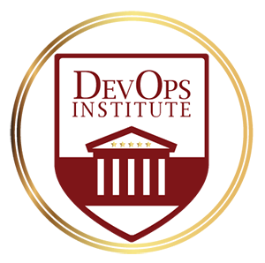
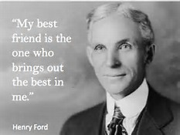
How To Make ITSM Your New Best Friend
Jayne Groll
DevOps Institute

Slide 2

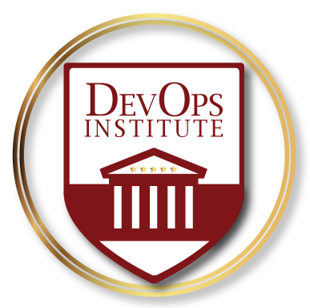
About Me
Board member and co-founder of the DevOps Institute, President of ITSM Academy, active trainer, ScrumMaster, ITIL® Expert and former IT Director. Author of the Agile Service Management Guide.
Jayne Groll
The DevOps Institute is the global learning community for emerging DevOps practices. DOI’s enterprise grade DevOps education, training and certification is being delivered worldwide through our channel of Registered Education Partners.

Slide 3

WHY Aren't DEVOPS And ITSM Friends?

Slide 4
Myth: DevOps is Incompatible with ITSM
ITIL® has broadly influenced multiple generations of Ops practitioners and is an ever-evolving library of practices intended to codify processes and practices that underpin world-class IT Operations.
The DevOps Handbook
ITIL® is a registered trade mark of AXELOS Limited.

Slide 5

Overcoming ITSM Objections
Sometimes…
it’s not what you say but how you say it

Slide 6

Change Management
Change management is not a one size fits all process.
Common Objections
Too many risky behaviors
All changes must submit a RFC to the CAB at least 7 days in advance
We never know what changed and when
Agree on change models to differentiate levels of rigor and control.
Use automation to create and update change records and schedules.
Put an Ops person on a Scrum team.
Notes:
Change management should never be a one-size-fits all approach. The best way to overcome the objection to
“You must submit a RFC at least 7 days in advance for CAB approval”
“How will we know what changed and when?”

Slide 7

Everyone Wants More Standard Changes
Per ITIL® a standard change is
Pre-authorized
Low risk
Relatively common
Follows a procedure or work instruction
Not required to submit a RFC
Able to be logged and tracked using a different mechanism
Could DevOps and ITSM agree that most changes going through an automated deployment pipeline be designated as “standard”?
Based on AXELOS ITIL® material.
ITIL® is a registered trade mark of AXELOS Limited.
Notes:
Recording a standard change could be template or attachement based – minimal documentation

Slide 8

Release and Configuration Management
DevOps gives Release Management and Configuration Management more consistency and real-time data.
Common Objections
We are sacrificing quality for speed
Tools and definitions are not aligned
Configuration data is not passing to Ops
Engage ITSM managers in the design of the deployment pipeline.
Demonstrate that testing is more robust than ever.
Provide access or build APIs to Dev configuration management data.
Notes:
ISO 20K – 1 page to every process but Release (11 pages)
Here is where NoOps could be evolved into NewOps
Are release units the same as microservices?

Slide 9
Incident and Problem Management
If the deployment pipeline ends at release, where is the interface to an operational pipeline?
Chat
Common Objections
The Service Desk is the last to know
Incident records are not maintained
Developers are not available
Knowledge is not being shared
Too much emphasis on MTTR
Ops
Use automation to create and maintain knowledge and records.
Engage ITSM teams in ChatOps.
Agree on service level and resolution metrics.
Notes:
Automation Opportunities
Automated incident detection and recording
Self-healing technologies
ChatOps for collaborative problem solving
Shared dashboards with social aspects
Integration with ITSM tools

Slide 10

This Could Be The Beginning of a Beautiful Friendship
Trust each other’s strengths, experiences, integrity and expertise
Control without being controlling
Create common vocabularies, processes and metrics
ITSM
Share tools and knowledge
DEVOPS

Slide 11
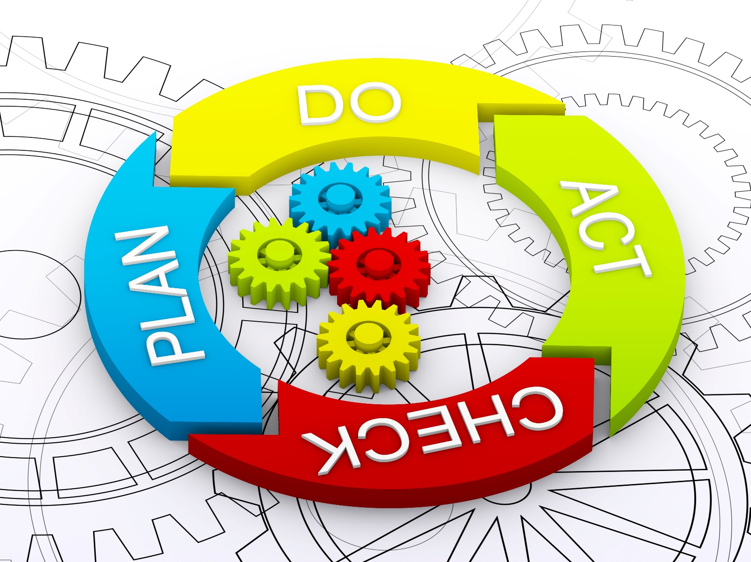
Collaborate and Continually improve
The most important “continuous” of all

Slide 12

Thank You!
Questions?
Jayne Groll
jgroll@devopsinstitute.com
@ITSM_Jayne
www.devopsinstitute.com

